Slide 1


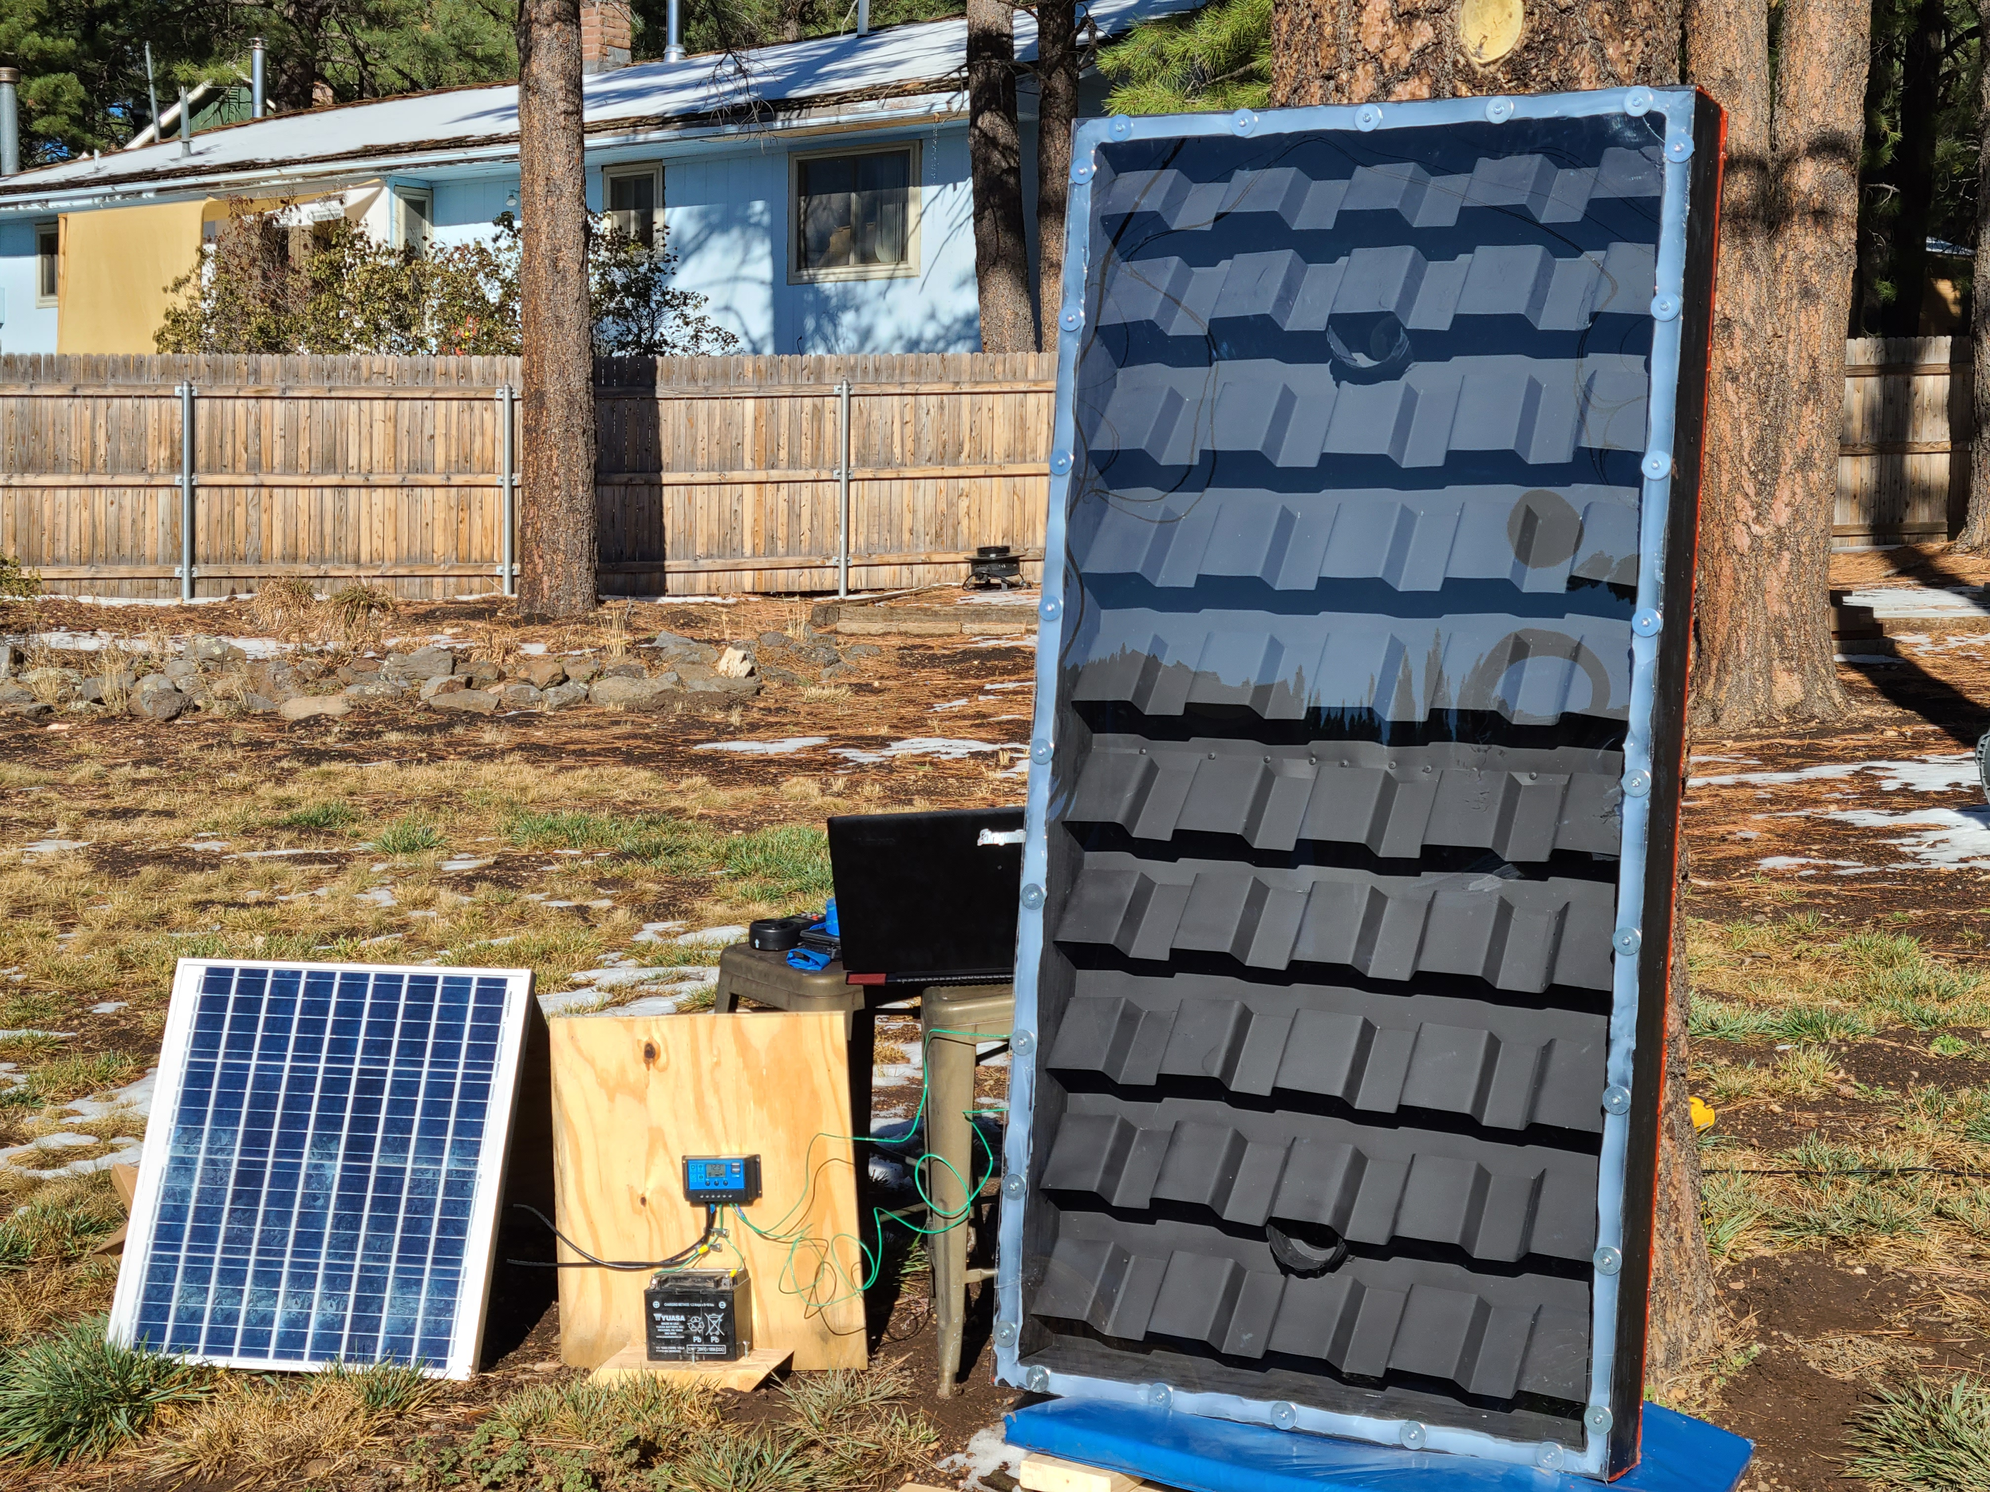
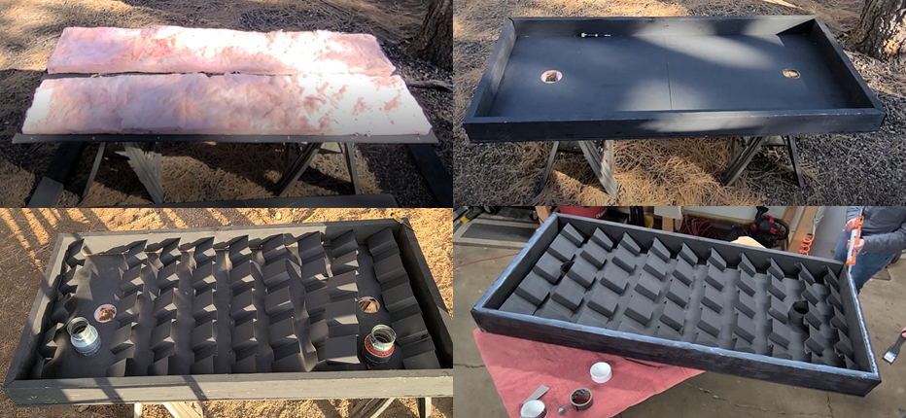
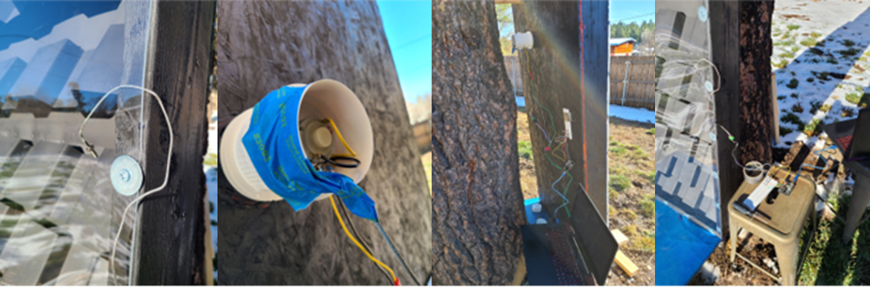
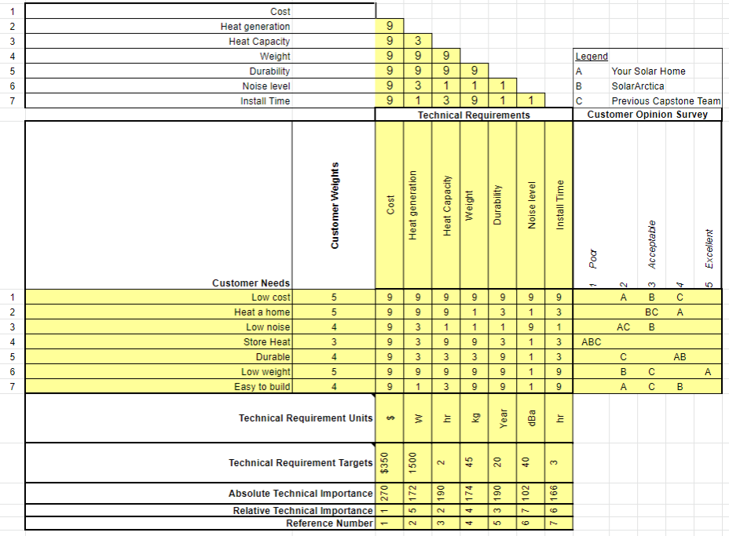
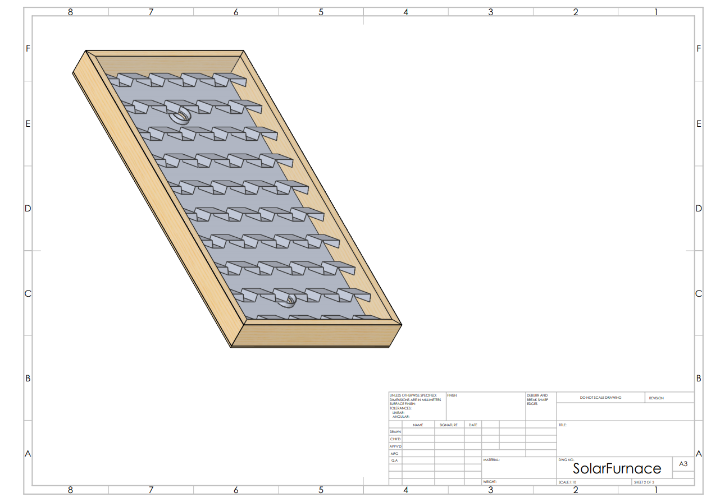
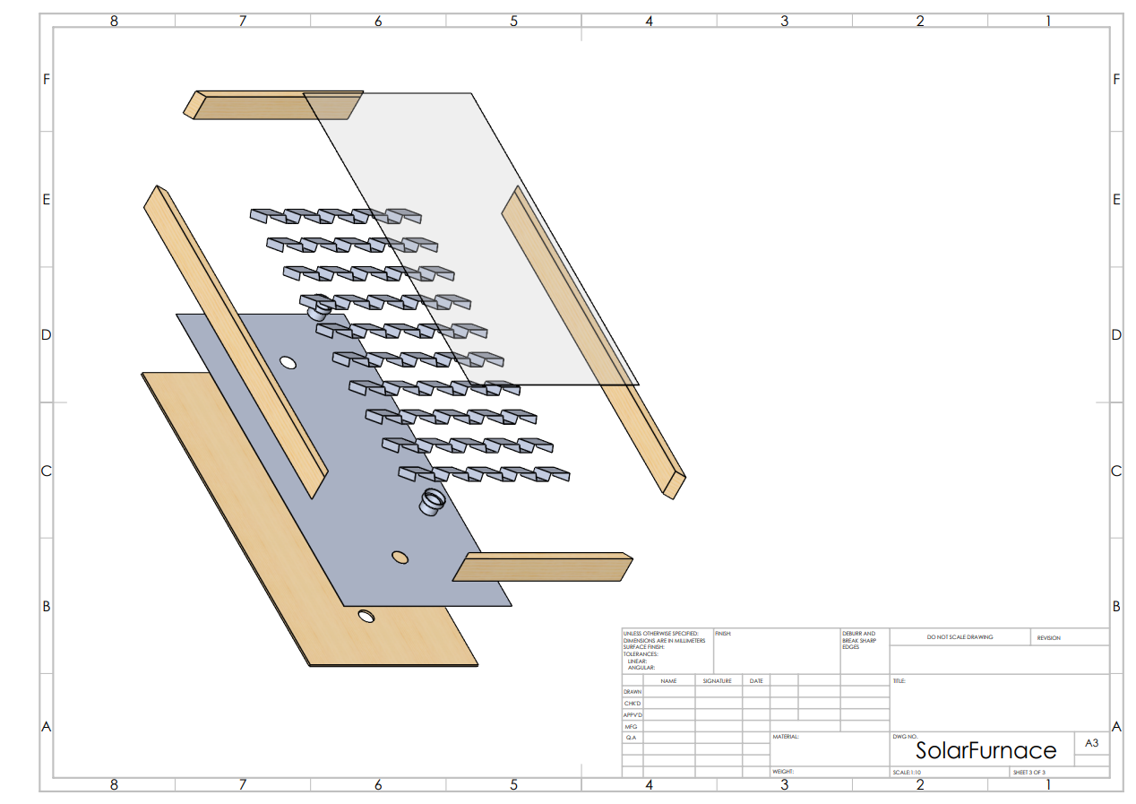

Red Feather Solar Furnace
Nathan Fisher, Leann Hernandez, Trevor Scott
Dr. Sarah Oman
College of Engineering and Informatics, Northern Arizona University, Flagstaff, AZ 86011
Abstract
Manufacturing & Testing
Conclusion
The NAU Capstone team is partnered with Red Feather to design a fully renewable solar furnace. Red Feather is a non-profit organization that helps the Native American people with their housing needs on the reservation. The Residents of the reservation in Northern Arizona previously received coal from a mine supplying the local power plant (Navajo Generating Station) which they burned to heat their homes, but both were shut down in November of 2019. In addition this, the inhalation of coal is known to cause respiratory illnesses. Thus the NAU Capstone team was tasked with designing a long term and sustainable solution to their heating needs. A solar furnace was chosen based off these requirements.
Multiple customer needs and engineering requirements, developed with the customer, were considered in designing the solar furnace. The final design was developed from a decision matrix and refined using both engineering computations, as well as a comprehensive analysis of the failure modes of the device. System heat loss, fan optimization, and solar technology were researched to better understand what materials and what configuration would be best for the device. Only basic power tools will be needed to construct the solar furnace and Red Feather will be provided with a construction manual and video to help with replication of the device which will be distributed to those on the Native American Reservation. [1]
The device was tested using an anemometer and thermocouples paired to an Arduino computer. The anemometer recorded the air speed leaving the device, which remains steady if the fan is received power from the photovoltaic solar panel. Over the period of a day the Arduino-thermocouple system took measurements. These measurements were then used to calculate the heat output over the course of a day using equation 1 below.
Equation 1: $\dot{Q}=QρC_{p}∆T$ [2]
Where $\dot{Q}$ is the heat generated in Watts, Q is the volumetric flowrate of air through the device, ρ is the density of air, $C_{P}$ is the specific heat capacity of air, and $∆T$ is the temperature difference between the air entering and leaving the device.
Figure 1. Stages of Device Construction
Figure 2.Testing Setup
The solar furnace was able to output 1684 Watts of heat which is better than the commercial options making it a success.
The final cost to create the prototype was $438. The commercial option costs between $700-900.
For bulk pricing for 100 units for the prototype size of 3’ x 6’ would be $384 per unit.
Should they pursue the team's model as a replacement for the commercial models used, Red Feather would save $316 per unit.
A cost analysis was also conducted for a larger 4’x8’ model which would cost $424 per unit based on bulk pricing.
Figure 4. Solar Furnace Prototype
Requirements
The customer requirements include:
low cost
able to heat a home
durable
low weight
Easy to build.
Quiet System
These translate into the primary engineering requirements:
Produce at least 1500 watts/day.
Less than $450
Weight: <100lbs.
Robust construction and materials
Fan noise between <40 dB
Install time under 3 hours.
The team successfully met all engineering requirements. The Quality Functional Diagram can be seen below:
References
Results
[1]“Red Feather Solar Furnace 2,” Northern Arizona University, Jan-2020
[2] F. P. Incropera, T. L. Bergman, D. P. Dewitt, and A. S. Lavine, Incroperas Principles of Heat and Mass Transfer. John Wiley & Sons, 2017
[3]Heat Loss in PV Modules,” PVEducation. [Online]. Available: https://www.pveducation.org/pvcdrom/modules-and-arrays/heat-loss-in-pv-modules. [Accessed: 30-Mar-2020].
[4]“Sizing Fans and Ducting for Solar Air Heating Collectors,” Sizing Fand and Ducting for Solar Air Heating Collectors. [Online]. Available: https://www.builditsolar.com/Projects/SpaceHeating/FanSizing/FanSizing.htm. [Accessed: 28-Mar-2020].​
[5]“OD1238-12HB-ORIN,” Orion - Axial Fans | Galco Industrial Electronics. [Online]. Available: https://www.galco.com/buy/Orion/OD1238. [Accessed: 30-Mar-2020].
[6] M. D. Egan, Concepts in thermal comfort. Englewood Cliffs, NJ: Prentice-Hall, 1975. ​
[7]Thermal Conductivity of Metals, Metallic Elements and Alloys. Engineeringtoolbox.com,
.
The heat output test revealed the device generated a max of 1684.95 watts of heat in ideal conditions.
This is enough heat energy to heat 500- 800 square feet comfortably throughout a Flagstaff winter.
The similarly sized commercial model claims to output 1500 watts of heat, meaning the prototype is about 112% as effective of the commercial option, with only a slightly larger footprint.
Figure 3. CAD Model of Solar Furnace Prototype.
Table 1: House of Quality
Acknowledgements
Red Feather L.L.C.
NAU Mechanical Engineering Department
Chuck Vallance
Dr. David Trevas
Dr. Sarah Oman

